Slide 1
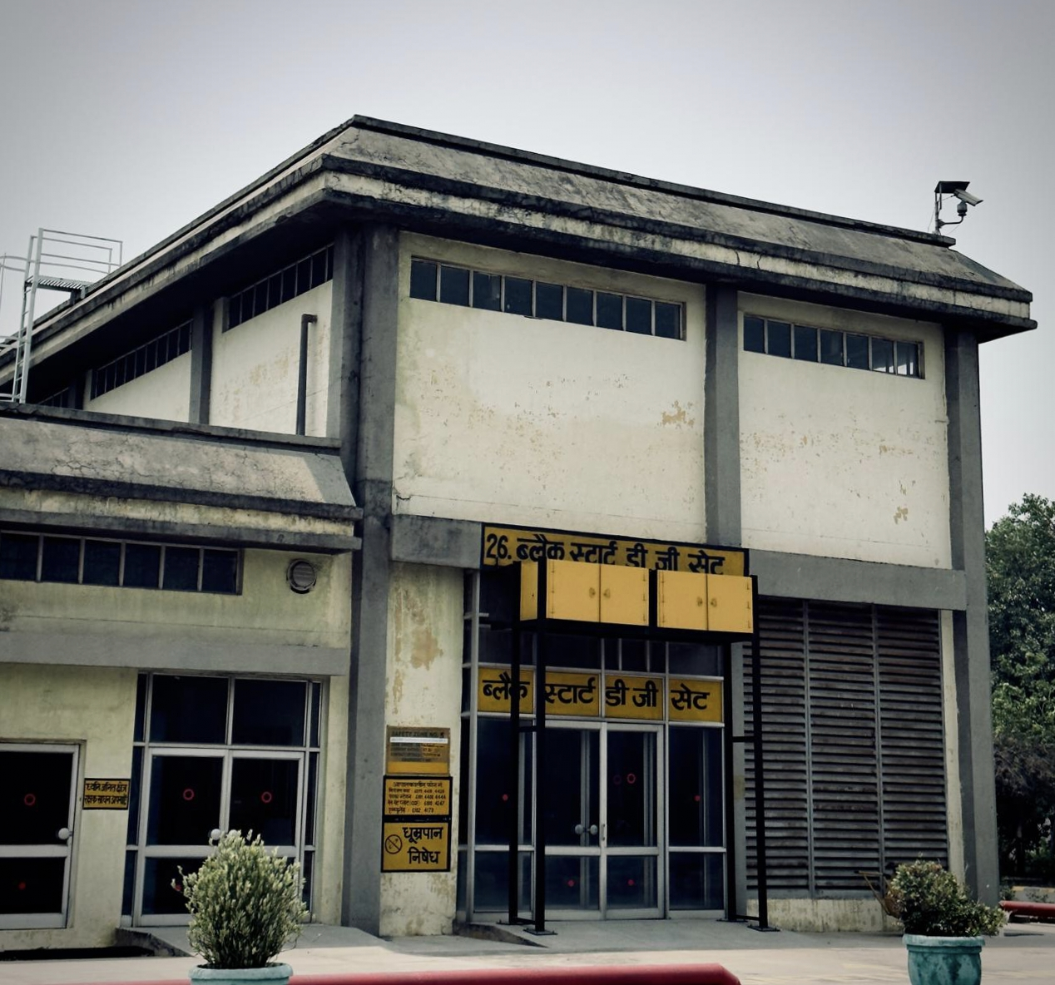

Black Start DG Set

Slide 2
Introduction
A Black Start Diesel Generator (BSDG) Set is a special generator used to restart a power plant when the entire grid is down — this condition is called a blackout.
It provides the initial power needed to start larger generating units without relying on the external electric power (Samaypur – 400KV Grid).
The Black Start DG set is part of the plant safety and emergency system.
Usually diesel-based (reliable & quick start)

Slide 3
It is rarely used; periodic testing is mandatory.
The Black Start DG set at NTPC Faridabad can support up to 3.3 MW load.
It has both automatic and manual start modes, but it's usually kept in auto mode.
The BSGG rotor rotates at 1000 rpm when it starts and generates 6.6 kV of voltage.
This 6.6 kV supply is connected to Tie Feeder 1 and 2 of the Medium Voltage Switchgear, which helps start all operational motors and pumps used in electricity generation.

Slide 4
Working of bsdg
Whenever a blackout occurs, the Black Start DG automatically initiates the starting process.
Before starting, the system checks two critical conditions:
a. Compressor Pressure – maintain or not .
b. Solenoid Valve Status – active or not.
3. If Both Conditions Are Satisfied.
4. A 24V DC control signal is generated using 12 –
(2V) cells that are already charged .

Slide 5
5. These batteries supply 24V DC to the control
circuit.
6. The control circuit sends a start command to
automatically initiate the BSDG generator.
7. The compressed air (from the air compressor)
provides the initial torque required to rotate the
BSDG rotor during starting. This eliminates the
need for an external starter motor.
8. Then Supply all the essential motor and pump
used in power generation and supply power to
power plant in Black-out condition.
Amara Raja is the manufacturer of the 12 x 2V batteries.

Slide 6
Black Start DG Set
Special Thanks :
1. S.S Narula Sir
2. Kaushal Sir
Thank You

